Slide 1
Exploring student engagement with academic staff
Workshop Five
The course rep role.
Editable slide pack.

Slide 2
1. Understanding the course rep role

Slide 3
What do you think is the role of the course rep?

Slide 4
What is the purpose of the course rep in contributing to…
Representation
Partnership
Enhancement

Slide 5
Why should course reps communicate with…
Course reps
Students on their course
Students’ association
Teaching staff

Slide 6
The course rep role description
[Insert or share the role description or person specification for course reps at your institution.]
Where does this role link with yours?
How can you support the tasks of reps as described?
How should you be benefitting from the role as described?

Slide 7
How we train course reps
[Insert a summary of course rep training, or use the SLE and ABCD diagrams that follow.]

Slide 8
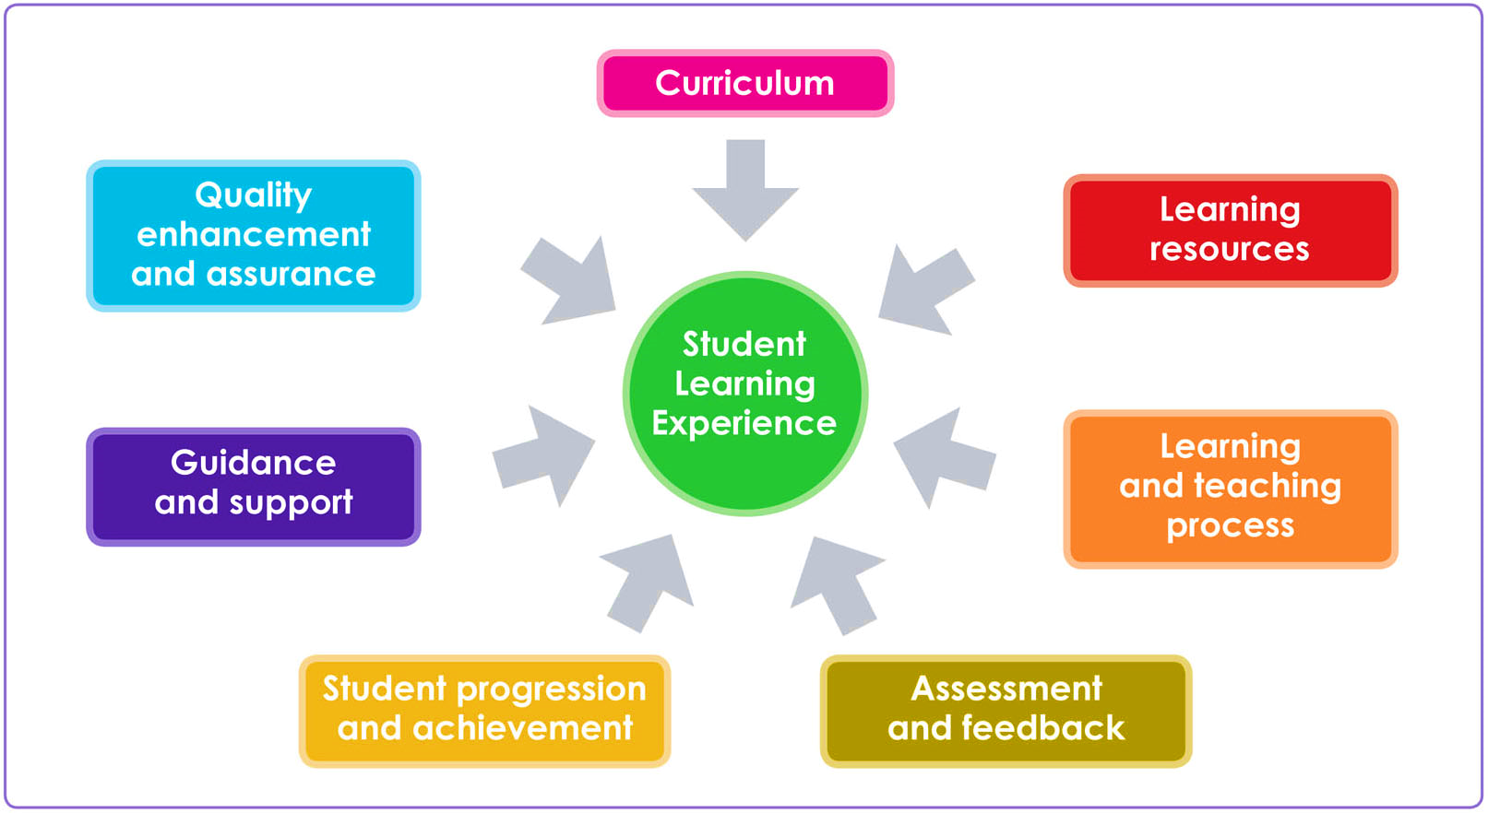
The Student Learning Experience
Notes:
Introduce this by asking the whole group to come up with ideas about they understand by all of the headings on the SLE – Curriculum, Learning Resources, Learning and Teaching Process etc.

Slide 9
Promoting the course rep role
Have a look at sparqs’ resources here and here.
What successes from last year can you share about the course rep role in your institution, department and course?

Slide 10
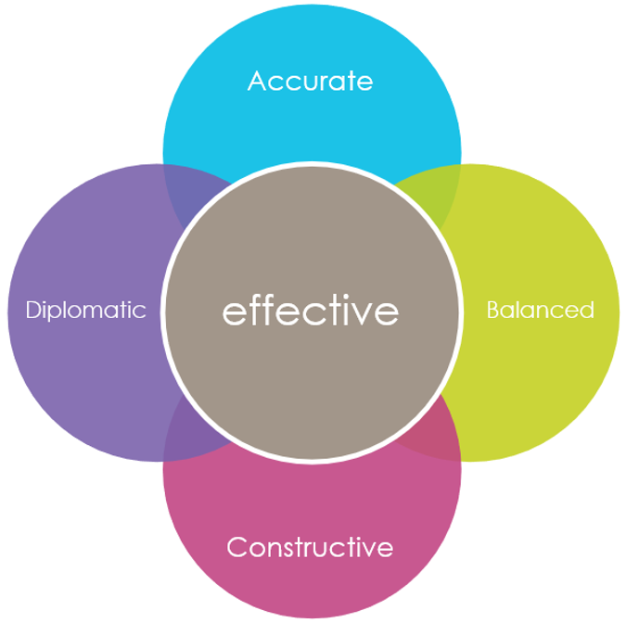
A reminder of the ABCD
Accurate. Truthful, specific, supported by evidence.
Balanced. Positive feedback, not just negative.
Constructive. Can you suggest solutions?
Diplomatic. Tactful. Avoid blaming individuals. Focus on learning.
Notes:
A reminder of the A B C D
We met the four points A B C and D in the self-study units. They are summarised on this slide, and reps can find more details in the resource pack.
Briefly review the meaning of A B C and D.
Trainers, this is a brief recap. It is not necessary to read every word.
A Accurate
This is about being truthful and giving sufficient information.
Be specific and provide the relevant data and/or evidence for what you are saying.
B Balanced
This is about giving positive feedback, and not just complaining.
You may receive negative feedback more frequently, but it is equally important to emphasise the parts of the course that are good. This will help you to develop a good working relationship with staff and may help them remain open to your suggestions.
C Constructive
This is about helping to find solutions to the difficulties raised. In some cases, you may be able to suggest solutions for staff to consider. Effective feedback can be paired with effective answers.
D Diplomatic
This is about being tactful. Critical feedback does not have to blame individuals. Tackle the issue and not the person. Focus on the learning of your class, not on the actions of your tutor.

Slide 11
2: Shaping the course rep role

Slide 12
Complete the sentences
I love it when course reps…
I wish course reps…

Slide 13
A year in the life of a course rep
What happens (or should happen) in each month of the year with course reps? Think about:
Term dates and teaching timetables.
Meetings.
Quality processes.
Add in where staff (should) have a role in this.

Slide 14
Creating a course rep job description
The overall purpose.
The tasks.
Who you work with.
Who supports you.
How much time is involved.
The skills you need.
The skills you gain.
What you might do next.

Slide 15
3: Engaging course reps in committees

Slide 16
Course reps’ hats
Witness | Representative | Shop steward | Negotiator
Diplomat | Ambassador | Spokesperson | Advocate
Evangelist | Auditor | Spy | Intermediary
Leader | Colleague | Apprentice | Listener
Governor | Learner | Professional | Emancipator
Opinion pollster | Interpreter | Reviewer | Rebel

Slide 17
Before meetings
Check the location and time of the meeting. If you need to arrive late, inform the chair/secretary well in advance.
Check whether the meeting will focus on any particular topics.
Gather the views of your classmates. Summarise these so you can give a concise account. Where appropriate, use the ABCD model.
Do you have any item to add to the agenda (based on feedback from classmates)? Contact the chair/secretary of the committee to request this.
Read the meeting papers including the minutes (notes) of the previous meeting.
Ask the students’ association for help if there are matters that you do not understand.
In some cases you might consult with other reps to check if their courses share similar concerns.

Slide 18
During meetings
Take a notebook with you. In matters relevant to your course, participate actively in discussions and take adequate notes.
Arrive on time (whether in-person or online).
When giving the opinions of classmates, remember the ABCD of effective feedback.
Don’t be afraid to ask questions. Staff will probably use jargon and technical language, and it is ok not to understand something. (But it is less ok if you were not listening!)
Listen carefully to other speakers, so you can respond or ask questions.
Support other course reps in the meeting.

Slide 19
After meetings
Reflect on your contributions to the meeting. Did you achieve what you intended? What could you do differently?
Report back to your classmates a brief summary of any relevant outcomes or decisions made. You may be able to arrange a few minutes to speak to the class, if you ask your tutor.
Check the minutes (meeting notes) when they are sent out. If you believe something important has been missed, you can contact the chair.
Check if you have any action points. Make sure you do anything you have been asked to do.
Are there any points that you should follow-up with your tutor or with the students’ association?

